Slide 1
Facilitating Conduct of Remote Monitoring for Clinical Trials: Key Considerations for VA Researchers
Lead Presenter: C. Karen Jeans, PhD, CCRN, CIP
Office of Research Protections, Policy, & Education
VHA Office of Research and Development
Department of Veterans Affairs
June 18, 2020
Dial in (Main): (562) 247-8422
Dial in (Alt): (702) 489-0006
Attendee Access Code: 858-201-010
Slides in “Handout” Tab

Slide 2
Objectives
Identify urban myths related to remote monitoring in VA research.
Identify key steps for VA research team members to use to facilitate conduct of remote monitoring visits with an external monitor for a clinical trial using collaboration technology platforms.
2

Slide 3

True or False: VA Does Not Permit External Monitoring of Clinical Research
3

Slide 4
True or False: VA Does Not Permit External Monitoring of Clinical Research: ANSWER
4

Slide 5
FDA Regulations Requiring Monitoring of Clinical Trials
21 CFR Parts 312 and 812
c
(d) Selecting monitors. A sponsor shall select a monitor qualified by training and experience to monitor the progress of the investigation.
21 CFR 312. 53(d)
(d) Selecting monitors. A sponsor shall select monitors qualified by training and experience to monitor the investigational study in accordance with this part and other applicable FDA regulations.
21 CFR 812.43(d)
5

Slide 6
VA Absolutely Permits External Monitoring of Clinical Trials
VA has never prohibited external monitoring of clinical studies (primarily clinical trials).
Regulatory requirements must be met:
  Informed consent
  HIPAA authorization
June 7, 2010 VA Memorandum: Guidance on Implementation of Approved Methods for Clinical Trial Monitor Access
  Described two methods for clinical monitors to access VA patients’ Electronic Health Records (EHR) for clinical trial monitoring:
  1. Limited Read Only Access to Selected Data within the EHR
  2. VA Employee “Driver” Method
6

Slide 7
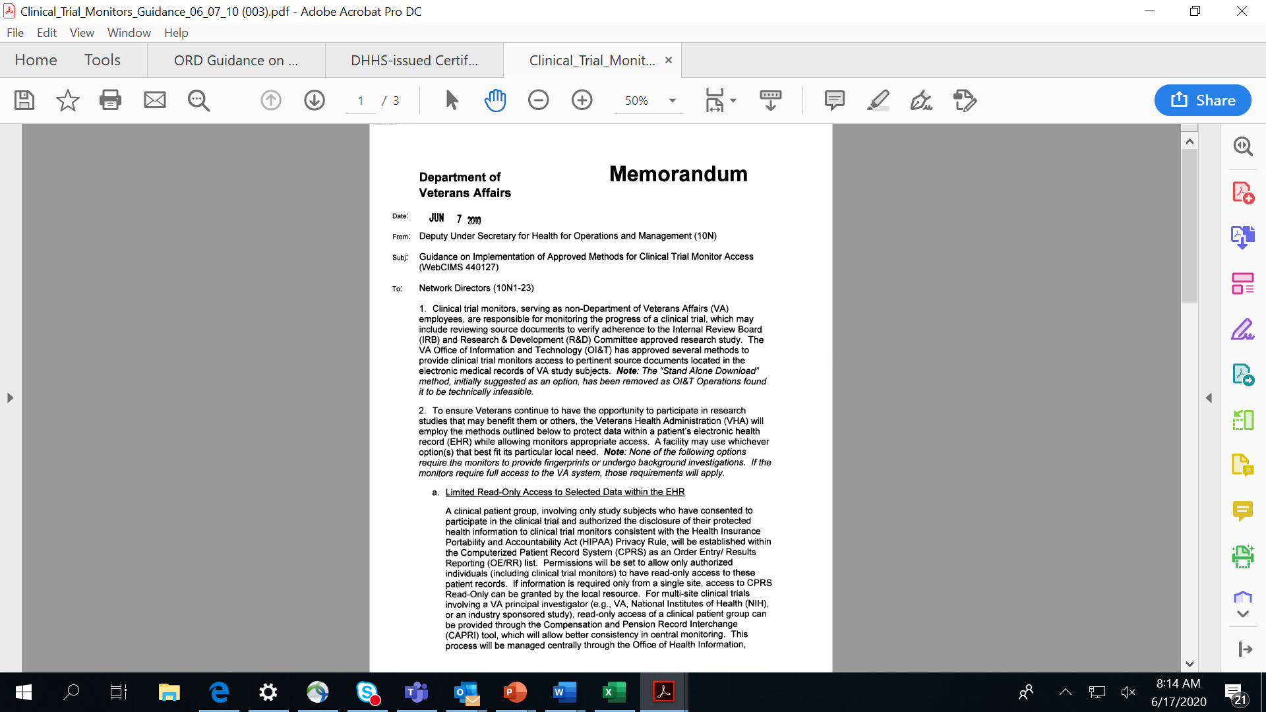
June 7, 2010 VA Memorandum: Guidance on Implementation of Approved Methods for Clinical Trial Monitor Access
7

Slide 8

True or False: VA Does Not Permit Remote Monitoring of Clinical Research
8

Slide 9

True or False: VA Does Not Permit Remote Monitoring of Clinical Research: ANSWER
9

Slide 10
VA Permits External Monitoring of Clinical Trials Using Remote Monitoring
External Monitoring of Clinical Trials
External Monitoring of Clinical Trials Using Remote Monitoring
VA has never prohibited external monitoring of clinical studies (primarily clinical trials).
Regulatory requirements must be met:
  Informed consent
  HIPAA authorization
June 7, 2010 VA Memorandum: Guidance on Implementation of Approved Methods for Clinical Trial Monitor Access
  Described two methods for clinical monitors to access VA patients’ Electronic Health Records (EHR) for clinical trial monitoring:
  1. Limited Read Only Access to
  Selected Data within the EHR
  2. VA Employee “Driver” Method
VA has never prohibited remote monitoring of clinical trials.
Regulatory requirements must be met:
  Informed consent
  HIPAA authorization
VA OI&T-approved collaboration technology platforms must be used.
  Examples:
    Webex
    Skype
    Microsoft Teams
ORD Guidance issued June 18, 2020 utilizes the VA Employee “Driver” Method described in the June 7, 2010 VA Memorandum: Guidance on Implementation of Approved Methods for Clinical Trial Monitor Access
10

Slide 11
ORD Guidance on Remote Monitoring of Clinical Trials Issued June 18, 2020
ORD Guidance on Remote Monitoring of VA Clinical Trials by External Monitors Using the Webex Collaborative Technology Sharing Platform (June 18, 2020)
  Not a single set of implementation practices that must be used.
  Designed as an implementation guide for the use of Webex to conduct remote monitoring for clinical trial monitoring requiring access to protected health information and the Electronic Health Record (EHR) using a VA employee as the driver of the documents.
  Does not address other types of VA-approved collaboration technology sharing platforms that could be used to conduct remote monitoring, including Skype and Microsoft Teams.
  Describes suggested sequence of steps for facilitating a remote monitoring visit by a clinical trial monitor.
11

Slide 12

ORD Guidance on Remote Monitoring of Clinical Trials Issued June 18, 2020
The June 18, 2020 ORD guidance is:
  Not an ORD policy document;
  Not an ORD guidance document on the functionalities of Webex or any collaboration sharing technology platform;
  Not an ORD guidance document on how to request access or use CPRS/VISTA or Joint Legacy Viewer;
  Not intended to apply to monitors and auditors who are VA employees or are under contract to the VA to provide these services; and
  Not an ORD position that all clinical trial monitoring must be conducted remotely.
12

Slide 13
Sequence of Steps to Facilitate Remote Monitoring Visits in VA Research
  Equipment and Access Requirements to Conduct a Remote Monitoring Visit
  Verifying Regulatory Requirements Prior to Scheduling the Remote Monitoring Visit
  Scheduling the Remote Monitoring Visit
  Testing the Equipment Used to Conduct a Remote Monitoring Visit
  Preparing (Staging) Documents for Review
  Conducting the Remote Monitoring Visit: Record Review
  Ending the Remote Monitoring Visit
13

Slide 14
1. Equipment and Access Requirements
Seven (7) Steps to Facilitate
Remote Monitoring Visits in VA Research
2. Verifying Regulatory Requirements
3. Scheduling the Remote Monitoring Visit
4. Testing the Equipment
5. Preparing (Staging) Documents for Review
6. Conducting the Remote Monitoring Visit: Record Review
7. Ending the Remote Monitoring Visit
14

Slide 15
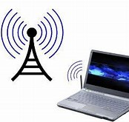
Step 1: Equipment and Access Requirements to Conduct a Remote Monitoring Visit
15

Slide 16
Step 1: Equipment and Access Requirements to Conduct a Remote Monitoring Visit
VA Employee must have access to VA’s Electronic Health Record through CPRS/VISTA or Joint Legacy Viewer (JLV).
  Either CPRS/VISTA or JLV can be used for remote monitoring visits.
  Detailed training on JLV can be found within the JLV platform: https://jlv.med.va.gov/JLV/app.
One VA research team member should be responsible for managing the computer during the monitoring visit.
  Stable internet connection
Camera capability is recommended either on the computer or through use of a web camera to be able to view the clinical trial monitor (and allow the clinical trial monitor to view the VA research team member).
16

Slide 17
Step 1: Equipment and Access Requirements to Conduct a Remote Monitoring Visit
The VA research staff member who will be facilitating the remote monitoring visit must set up a VA Webex account at https://veteransaffairs.Webex.com/.
  It is recommended that VA research staff members review and take Webex training to increase proficiency with its use.
  Webex resources are located at the Webex Meeting resource page: https://dvagov.sharepoint.com/sites/OITUCIS/Webex/SitePages/Webex.aspx
17

Slide 18
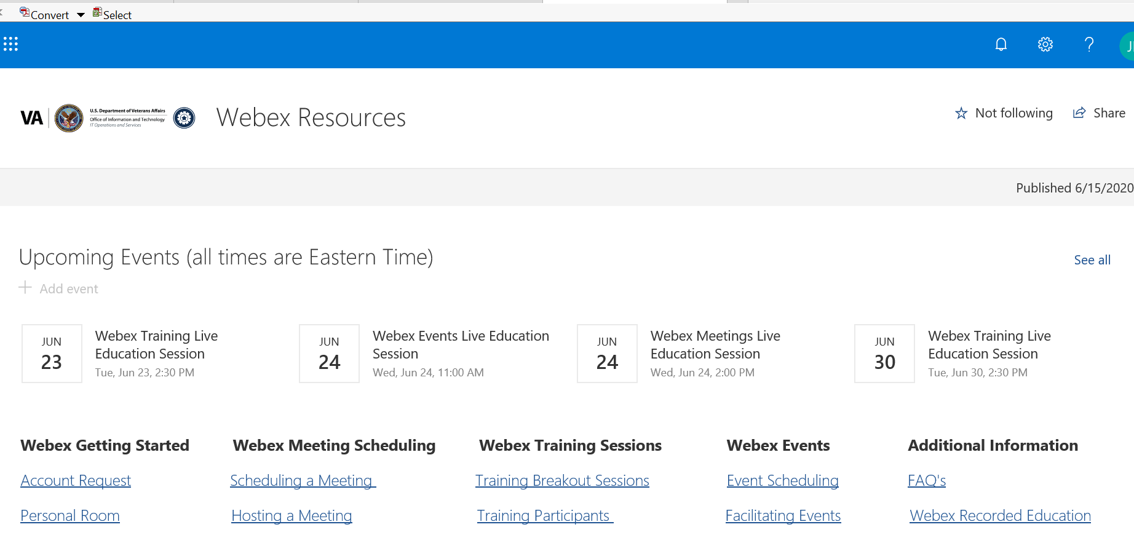
Webex Resource Page: https://dvagov.sharepoint.com/sites/OITUCIS/webex/SitePages/WebEx.aspx
18

Slide 19
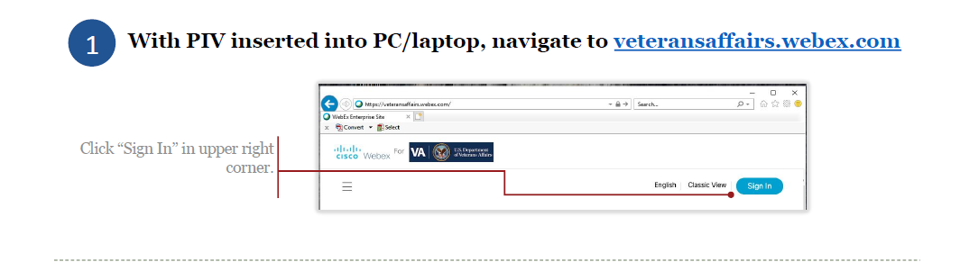
WebEx Meetings – Account Request
19

Slide 20
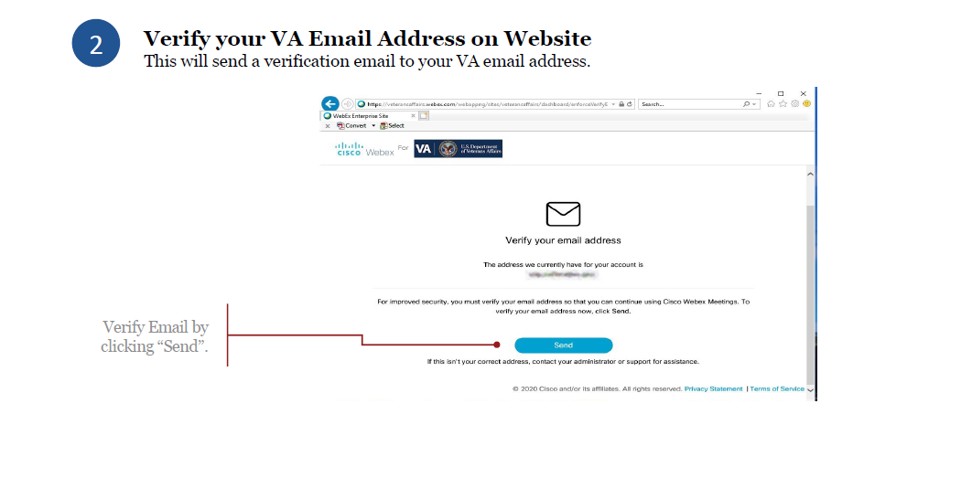
Verify your VA Email
20

Slide 21
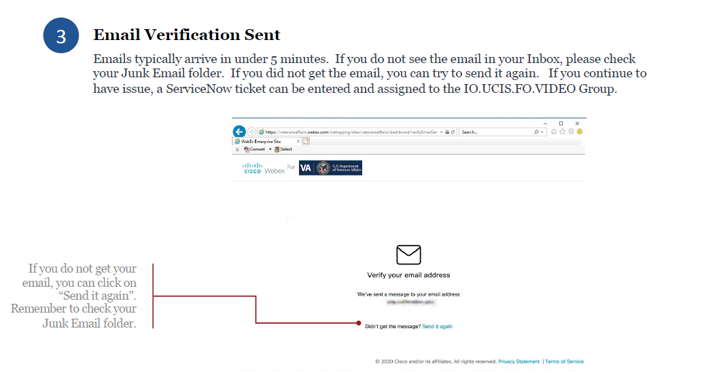
Email Verification
21

Slide 22
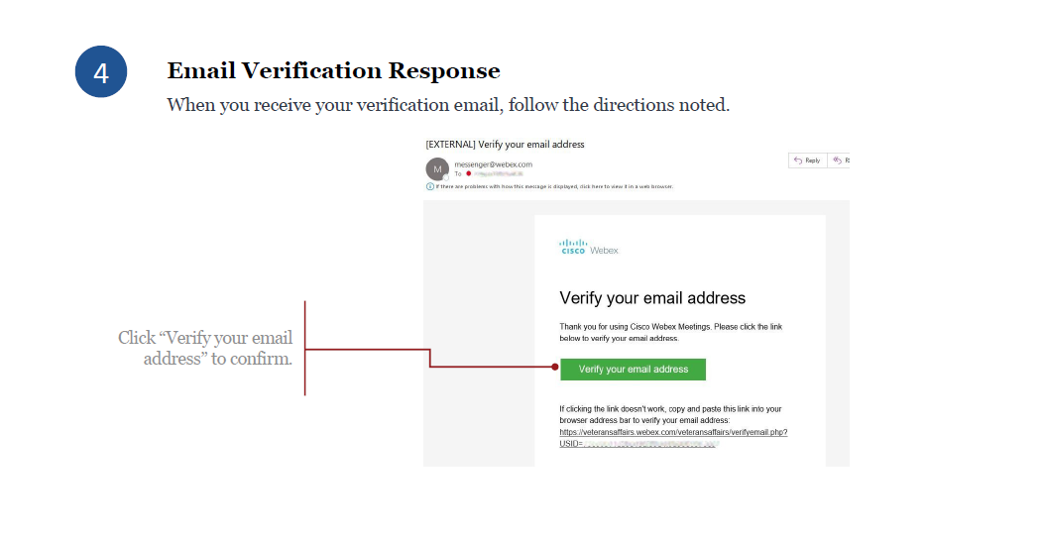
Email Verification Response
22

Slide 23
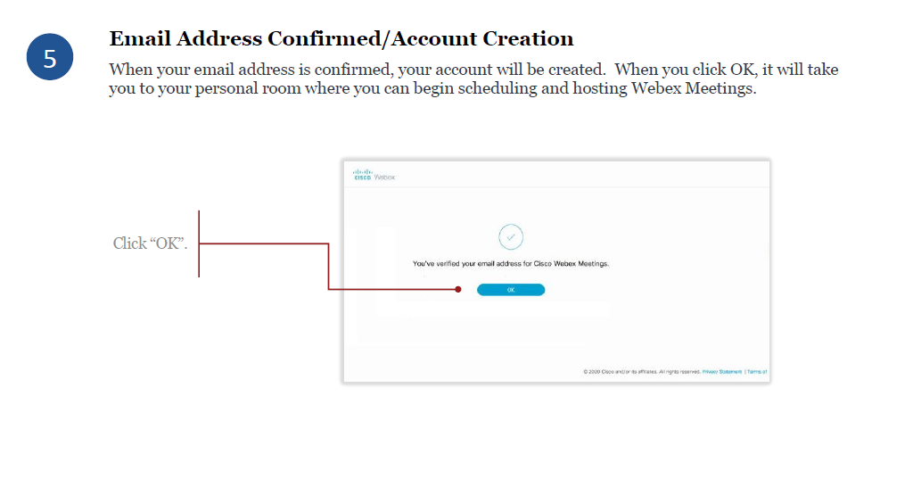
Email Address Confirmed
23

Slide 24

Step 2: Verifying Regulatory Requirements Prior to Scheduling the Remote Monitoring Visit
24

Slide 25
Step 2: Verifying Regulatory Requirements Prior to Scheduling the Remote Monitoring Visit
Verifying regulatory requirements is not unique to remote monitoring of clinical trials.
The VA research team member should ensure that a signed and dated HIPAA authorization and IRB-approved informed consent document permits access to the subjects’ records.
Verification of the regulatory requirements to allow access to the subjects’ individually identifiable information (III) for purposes of the remote monitoring visit could be done by:
  the VA research team
  another party (e.g., privacy officer) dependent upon local VA Facility requirements.
If a local VA Facility has specific documentation requirements, the local VA Facility documentation requirements must be followed.
25

Slide 26

Step 3: Scheduling the Remote Monitoring Visit
26

Slide 27
Step 3: Scheduling the Remote Monitoring Visit
  Do not assume clinical trial monitors use the same conference sharing platforms used in VA.
  Anticipate the need for a longer monitoring visit compared to an in-person visit
  Communicate in writing and/or orally what platform will be used (e.g. Web-Ex).
      Ask if the monitor has any specific requirements he/she must follow as part of a remote monitoring visit.
27

Slide 28
Step 3: Scheduling the Remote Monitoring Visit
  Request a list in writing to identify the subjects and records required for the record review component of the remote monitoring visit.
  Request a list of non-subject records required for the record review
      IRB approval documents
      Lab certificates
      Updated Form 1572s (if applicable)
      Research team member vitaes
28

Slide 29
Step 3: Scheduling the Remote Monitoring Visit
  Outstanding issues
        Prior visits
        Data queries
  Personnel needed for the remote monitoring visit
        Study staff
        ACOS/R&D
        Research Pharmacist
  Confirm scheduled dates and times
  Send a Webex invitation to the clinical trial monitor
        Use your personal Webex room
        Recommend minimum of five (5) business days prior to the scheduled remote monitoring visit.
29

Slide 30
Step 3: Scheduling the Remote Monitoring Visit
Follow local VA Facility policies as applicable for notification of remote monitoring visits
  VA Facility Research Office
  VA Facility Privacy Officer
  VA Facility ISSO
  VA Facility RCO
30

Slide 31

Step 4: Testing the Equipment Used to Conduct a Remote Monitoring Visit
31

Slide 32
Step 4: Testing the Equipment Used to Conduct a Remote Monitoring Visit
  Critical to facilitate a successful remote monitoring visit
  Schedule technical test with clinical trial monitor
      ORD recommends this be completed at least two (2) business days before the scheduled monitoring visit
      Test accessing the platform
      Test sharing a document (not VA subject records)
  Verify logistics of visit
      Dates and times
      Processes to be used
      Draft agendas for each day
32

Slide 33

Step 5: Preparing (Staging) Documents for Review
33

Slide 34
Step 5: Preparing (Staging) Documents for Review
  Increased time will usually be required
  Before preparing documents, create a draft/rough monitoring visit agenda
      If multiple days, it is recommended that a secure shared drive folder be created in CPRS/VISTA or JLV for each day
  Utilize computer desk hygiene
      Remove or file any documents, short cuts, etc., to minimize distractions and avoid inadvertent breaches
      Close unnecessary programs (including email)
      Enter the information of the subjects to be viewed so that only those specific subjects appear in the recently viewed dialog box in CPRS/VISTA or JLV.
      In the secure shared drive folder where electronic research records are stored, stage the documents and subject records in a folder created for that specific remote monitoring visit date(s).
34

Slide 35
Step 5: Preparing (Staging) Documents for Review
  Scan documents not available electronically
      Informed consent documents
      HIPAA authorizations
      Patient diaries
      IRB records
      R&D Committee documents
      The VA research team member should scan documents that are not available electronically (e.g. informed consent documents not scanned into the EHR) and organize into electronic files or organize the paper documents so that they can be held up for viewing using the camera.
  Scanned documents cannot be altered or modified.
  Ask clinical monitor if documentation is required for scanned documents:
      Example: Certification Letter for Scanned Documents: Remote Monitoring
35

Slide 36
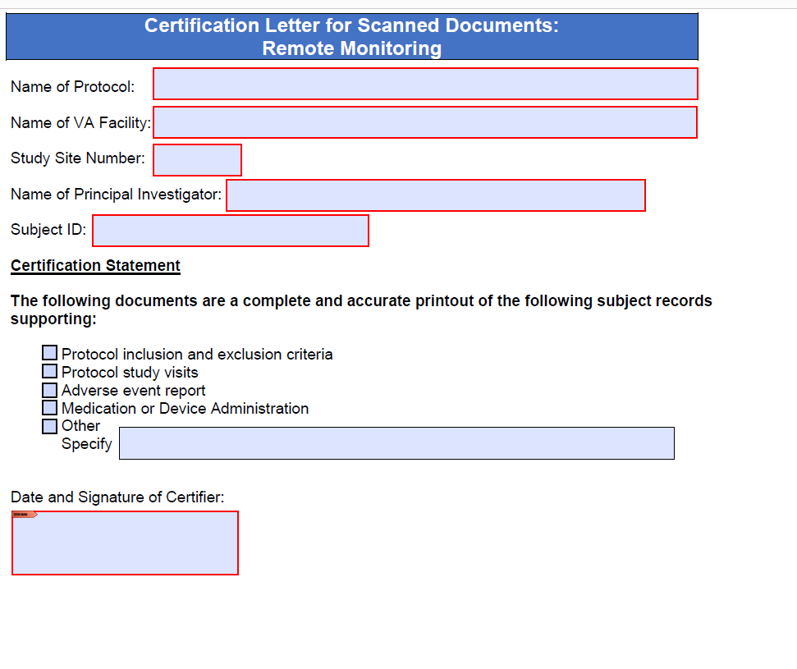
Step 5: Preparing (Staging) Documents for Review
Example: Certification Letter Template for Scanned Documents
36

Slide 37
Step 5: Preparing (Staging) Documents for Review
  All hard copy documents may not be available for scanning:
      Communicate with monitor prior to monitoring visit
      May require holding document up to camera for review by monitor.
37

Slide 38

Step 6: Conducting the Remote Monitoring Visit: Record Review
38

Slide 39
Step 6: Conducting the Remote Monitoring Visit: Record Review
  Anyone communicating with the clinical trial monitor is responsible to protect subjects’ privacy and confidentiality.
  One VA research team member should be responsible for managing the computer during the monitoring visit.
  If interactions with other site personnel are required during a virtual meeting, the VA research team member who is designated as the responsible individual must retain control of the computer at all times.
39

Slide 40
Step 6: Conducting the Remote Monitoring Visit: Record Review
The VA research team member should ensure that the following items are completed prior to the scheduled time:
  Close all non-relevant programs to include Outlook, Instant Messaging, etc. to prevent the accidental sharing of data that is not related to remote monitoring visit.
  If Skype is active, change his or her status to “Do Not Disturb”.
  Ensure all regulatory site documents are available and minimized until needed to be opened.
  Ensure that all outstanding issues from previous visits or data queries that are to be addressed during the visit are minimized until needed to be opened.
  Minimize any study specific “Patient Lists”.
40

Slide 41
Step 6: Conducting the Remote Monitoring Visit: Record Review
Initiate the WebEx meeting with screen sharing off
  only audio and video should be on prior to verifying credentials.
Verify clinical monitor credentials
  Monitor shows his or her respective identification using the camera function
  Other methods (email)
Review rules for the monitoring visit prior to beginning the visit
  Process to be used, and
  Review the agenda and adjust as necessary, resolve any unclear points. The VA research team member should not begin sharing the screen for review of records unless both parties are clear on the processes and goals for that day.
ORD recommends reinforcing to the clinical trial monitor that no screen shots during review of the EHR is allowed.
41

Slide 42
Step 6: Conducting the Remote Monitoring Visit: Record Review
Share the screen and begin review of the previously staged research records as outlined in the agenda.
If additional materials (documents, additional patients in the EHR) need to be reviewed that were not part of the originally agreed to list:
  stop screen sharing;
  stage these new materials and re-start screen sharing; and
  update any agendas or logs that may require an update of this information.
Stop screen sharing at any point in the meeting where active showing of research records is not required.
If it is necessary for the monitor to privately communicate with other members of the site study staff other than the VA research team member who is the responsible individual, a separate method of communication should be arranged.
42

Slide 43
Step 6: Conducting the Remote Monitoring Visit: Record Review
Sharing a login account is a violation of VA policy. The VA research team member in control of the computer must be the same VA research team member logged into the meeting.
If the virtual meeting occurs over several days, the VA research team member and clinical trial monitor should confirm the agenda for the next day so the next day’s materials can be staged.
43

Slide 44

Step 7: Ending the Remote Monitoring Visit
44

Slide 45
Step 7: Ending the Remote Monitoring Visit
Request how written observations or the written report of the monitoring visit will be sent by the monitor.
The VA research team member should select “end the meeting” (not “leave the meeting”) to terminate the meeting connection once the work for the meeting is completed.
The VA research team member should confirm that the Webex meeting has ended.
  Only the VA research team member can end the Webex meeting since it was created by him or her.
Destroy any scanned documents (such as scanned copies of the informed consent) created solely for purposes of conducting the document review portion of the remote monitoring visit.
Retain documents, such as certification letters, created or completed for the monitoring visit and file these documents with the study regulatory file.
45

Slide 46
Step 7: Ending the Remote Monitoring Visit
Follow local policies and requirements, if applicable, to notify the Research Office that the virtual meeting has ended.
46

Slide 47
Summary
  The principles for conducting a remote monitoring visit are similar to an in-person monitoring visit:
      Communication with your clinical monitor before, during and after a monitoring visit is an integral component of every visit.
      Defining the types of documents to be reviewed during the monitoring visit occurs prior to the actual document review portion of a visit.
      It is the responsibility of the study team (not the monitor) to prepare documents for review.
      Monitoring practices differ between studies and among monitors.
47

Slide 48
Summary
  There are also differences with conduct of a remote monitoring visit compared to an in-person monitoring visit:
      Remote modeling models are not standardized.
      Different Information security requirements are associated with remote monitoring.
      A longer amount of time is usually required for both preparing and conducting the record reviews.
      Practice with the collaboration sharing technology platform needs to occur prior to the date of the monitoring visit.
      Preparation (staging) of documents for record review is essential.
      Unforeseen events (such as issues with the technology) can occur.
48

Slide 49
Summary
Communication is critical for success of any monitoring visit.
49

Slide 50
References
FDA Guidance: June 7, 2020: “FDA Guidance on Conduct of Clinical Trials of Medical Products during COVID-19 Public Health Emergency – Guidance for Industry, Investigators, and Institutional Review Boards”
VA Memorandum: June 7, 2010: “Guidance on Implementation of Approved Methods for Clinical Trial Monitor Access”
VA Memorandum: April 7, 2020: “Use of Video Communication Technology for VHA Research and Development Activities under COVID-19”
VHA Directive 1200.05: January 7, 2019 (amended March 3, 2020): “Requirements for the Protections of Human Subjects in Research”
50

Slide 51

THANK YOU AND QUESTIONS
51

Slide 52
Availability of Recording
A recording of this session and the associated handouts will be available on ORPP&E’s Education and Training website approximately one week post-webinar
An archive of all ORPP&E webinars can be found here: https://www.research.va.gov/programs/orppe/education/webinars/archives.cfm
52

